Slide 1
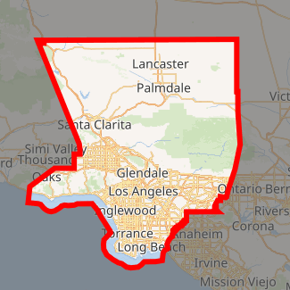
Suggest a neighborhood to open a gas station in Los Angeles
Capstone Project - The Battle of Neighborhoods

Slide 2
Background
Selecting a location to open a business is one of the most important decisions in running a business.
Business decision makers need to consider different factors in finding the right location for the business, such as financial factors, market factors, and the factors that will affect their demand and revenue.
This project can help business owners who are planning to open a gas station in one of the neighborhoods in Los Angeles.

Slide 3
Business Problem
To find the best neighborhood in Los Angeles to open a gas station.
A suitable neighborhood which has fewer compotators with more population.
A gas station is good be in a neighborhood with fewer convenience stores, competitors and more population.
A neighborhood that has fewer competitors is less risky for starting a new business.

